Slide 1
Is there a ‘migration crisis’ in South Africa?
Government response to the anti-foreigner mobilisation
Alan Hirsch
Nelson Mandela School, UCT, and New South Institute

Slide 2
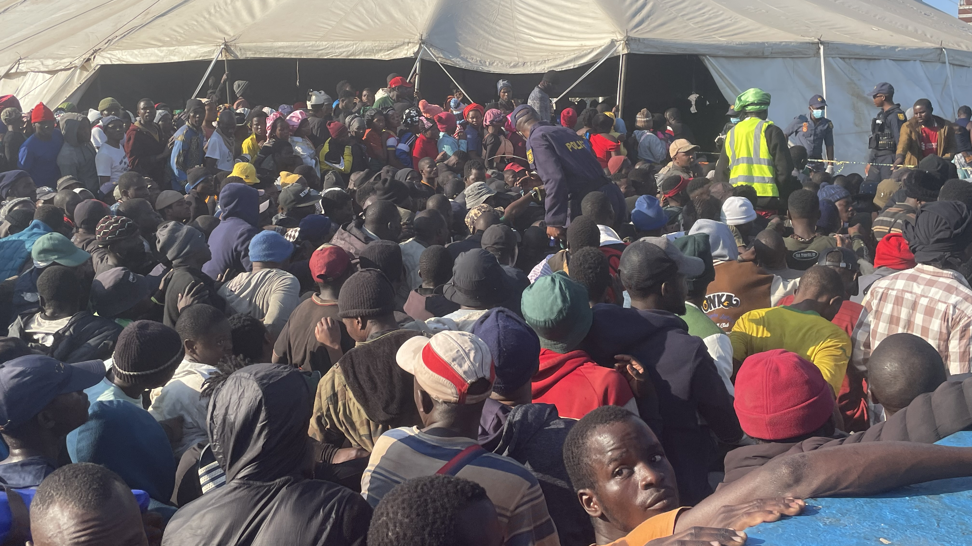
Notes:
Hundreds of people queued at the gates of the Old Drive-in site in Durban on Wednesday, waiting to get on buses to return to Malawi.

Slide 3
How many migrants are there in South Africa?
Estimates range between 2.4 million (3.6%) and 4.1 million (6%)
Official UN data is around 2.6 million (4%) in 2024
SA Census of 2022 very poor

Slide 4
Definitions and numbers
Definition of a migrant: a person living temporarily or permanently in one country who was born in another country
Total migrants in SA, highest estimate: 4.1m (6% of population), though official data indicate lower numbers
Refugees and asylum seekers in South Africa
  +/-69 000 official refugees
  +/- 94 000 asylum seekers
  +/- 86 000 official undocumented according to Scalabrini Institute
  Total +/- 250 000
  Probably too low by an order of magnitude—but still not huge

Slide 5
Compared with USA
Refugees: +/-2.2 million (SA 69 000)
Asylum seekers: >1.3 million (SA 94 000+)
Undocumented +/- 13 million (SA 86 000)

Slide 6
Is there a migration crisis? What do you think?

Slide 7
Rate of growth of migrant population in SA
Annual rate of change of migration into South Africa
1990-1995 | 1995-2000 | 2000-2005 | 2005-2010 | 2010-2015 | 2015-2020 | 2020-2024
-4.9% | -0.2% | +8.3% | +8.1% | +6.6% | -3.6% | -0.1%

Slide 8
Growth of migrant population in Uganda and South Africa
Total migrant stock in Uganda and South Africa
Country | 1990 | 1995 | 2000 | 2005 | 2010 | 2015 | 2020 | 2024
South Africa | 1 285 707 | 1 006 597 | 997 703 | 1 513 855 | 2 274 466 | 3 162 564 | 2 639 076 | 2 631 100
Uganda | 560 570 | 666 211 | 624 296 | 637 596 | 515 055 | 823 181 | 1 776 038 | 2 057 759

Slide 9
SA compared with other African countries
Countries in Africa with the largest percentage of foreigners living in them
Gabon | Eq.Guinea | Seychelles | Djibouti | Libya | Cote d’Ivoire | S Sudan | R of C | SA | Botswana
18.7% | 16.4% | 13.3 | 12.1 | 12.0 | 9.7 | 7.9% | 7% | 4.8% | 4.7%

Slide 10
Foreign-born in South Africa in global comparison
Proportion of foreign born to locally born –global comparison
Country | United States | Canada | United Kingdom | Germany | Australia | South Africa
Proportion | 15% | 23% | 16% | 19% | 32% | 4-6%

Slide 11
Why is there a perception of a migration crisis? Or, what is the crisis?

Slide 12
Migrant labour history
First large-scale foreign migrant labourers on SA mines and farms in the 1870s
At about 800 000 mine workers in the 1980s, 33% of workers were foreign migrants (266 000)
By 2000 total had fallen to about 418 000 but 60% were foreign migrants (251 000)
By 2024, direct formal employment in the mining sector had risen to 473 484 but only 40% were foreign migrants (189 000)
Is the rise in Zama Zamas and other illegals very surprising?

Slide 13
Regulatory implementation of immigration policy
Backlogs on asylum seekers
Backlogs on visas
Backlogs on birth certificates and IDs for citizens
Poor record keeping in DHA—poor tacking and tracing of individuals
Corruption endemic in ‘permitting section’ of the DHA
Current leadership trying to fix things: digitize, integrate systems, automate systems, remove corruption, cooperate with banks, strengthen border management…but

Slide 14
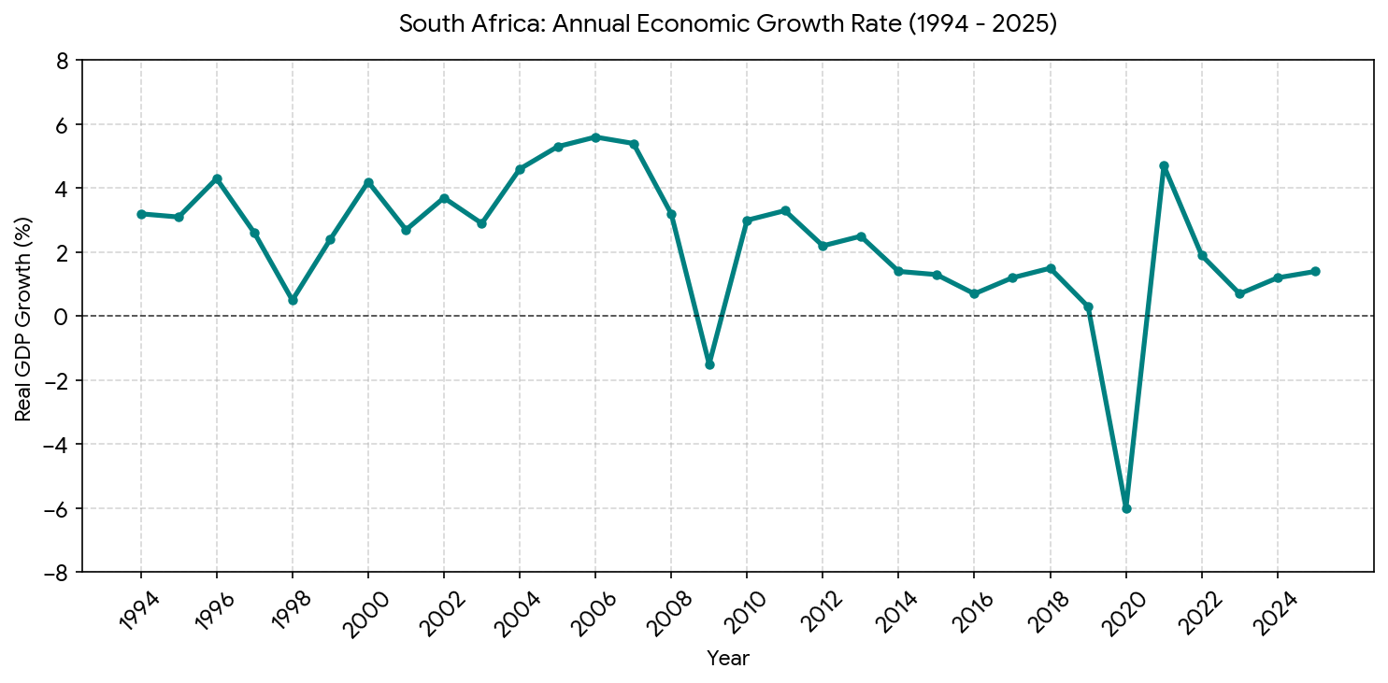
Economic growth record

Slide 15
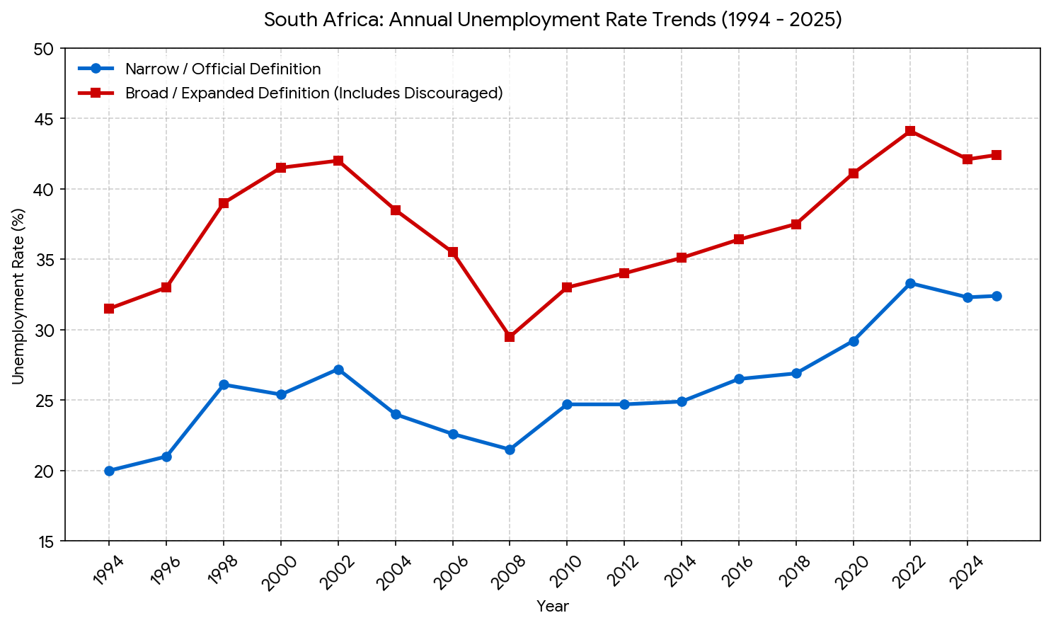
Unemployment rates in South Africa

Slide 16
Consumer debt

Slide 17
Rise of anti-foreigner sentiment in SA

Slide 18
Responses to the crisis

Slide 19
Ramaphosa letter
The recent violent protests and criminal acts directed at foreign nationals in parts of our country do not represent the views of South Africa’s people nor reflect our government’s policy.
These are the acts of opportunists who are exploiting the legitimate grievances, particularly those of the poor, under the false guise of ‘community activism’.
Some of these people are assuming functions that only state officials are permitted to perform, including stopping people to check identification and conducting searches of private property.
Such lawlessness will not be tolerated, regardless of who the perpetrators or victims are.

Slide 20
Ramaphosa letter
At the same time, as a society, we need to deal decisively – and within the law – with the challenge of illegal immigration, which risks our social stability, governance and national security.
Undocumented migration places strain on healthcare, housing and municipal services, particularly in poor communities. It distorts the labour market. In a country with high unemployment, some employers are exploiting undocumented, cheaper foreign labour over hiring citizens and paying them legal wages.
Not only is this fuelling social tension, it is actively undermining our labour protection regime and eroding the hard-won rights of workers.
Notes:
Then he goes on to explain the measures being undertaken by government to stop illegal migration, he encourages citizens and employers to support the state by not employing undocumented foreigners. What doesn’t he do? He doesn’t condemn violence and incate what action is being taken against those who incite hatred.

Slide 21
Ramphosa
Then he goes on to explain the measures being undertaken by government to stop illegal migration
he encourages citizens and employers to support the state by not employing undocumented foreigners
What doesn’t he do?
  He doesn’t condemn violence nor does he indicate what action is being taken against those who incite hatred
  He doesn’t draw on the evidence of recent migration patterns in SA
  Why not? What about other political leaders?

Slide 22
Ramaphosa’s ‘Five Point Plan’ (what’s missing?)
First: enforcement, including intensified action against violations of immigration and labour laws
Second: border security
Third: strengthening the immigration system through digital transformation and anti-corruption measures
Fourth: legal and policy reform including quotas for foreign nationals in certain sectors
The fifth pillar focused on asylum management—getting help from the UN and neighbours
Also committed to put in place security and other measures to deal with any attempts to destabilise our country, foreign or local

Slide 23
The concept ‘migration crisis’ and other issues of language

Slide 24
What should leaders be doing?

Slide 25
What about
Engagement with different spheres of government (KZN premier…)
  Other provinces, cities and towns?
Engagement with civil society:
    business community
    NGOs
    Civic organisations
What about regional cooperation on economic development
What about regional systems for labour migration? Or revised Bilateral Labour Agreements?
And actual clampdowns on agitators and violent mobs? Do we have a rule of law?

